Slide 1
Fast Adders
Lectures 28 & 29

Slide 2
Contd.
The final result of the addition will be valid after a delay of n Δ t, which is equal to 2n gate delays.
In addition to the delay in the ripple-carry path, there is also a delay in the XOR gates that feed either the true or complemented value of Y to the adder inputs.
If this delay is equal to one gate delay, then the total delay is 2n + 1 gate delays.
For a large n, say n = 32 or n = 64, the delay would lead to unacceptably poor performance.
Therefore, it is important to find faster circuits to perform addition.
The speed of any circuit is limited by the longest delay along the paths through the circuit.
In this case, the longest delay is along the path from the y_{i} input, through the XOR gate and through the carry circuit of each adder stage.
The longest delay is often referred to as the critical-path delay, and the path that causes this delay is called the critical path.

Slide 3
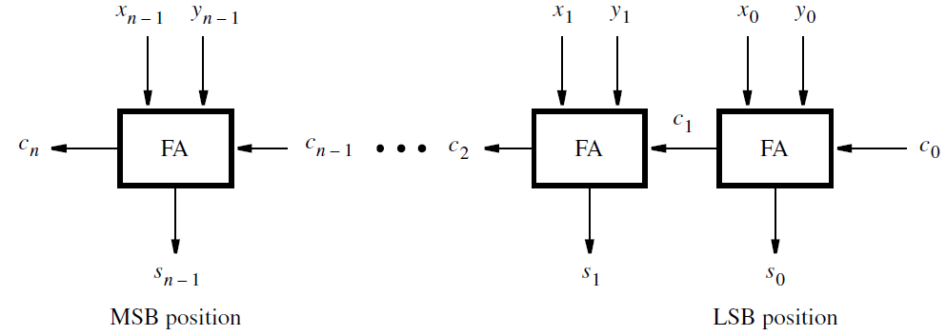
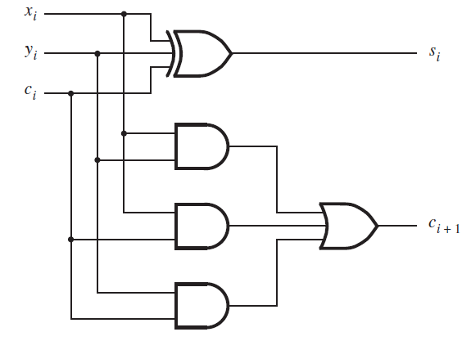
Fast Adders
The performance of a large digital system is dependent on the speed of circuits that form its various functional units.
It can be improved by changing the overall structure of a functional unit.
The ripple-carry adder has 2n+1 gate delays, so we need faster adders
1 Bit Full Adder

Slide 4
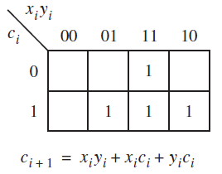
Contd.
To reduce the delay caused by the effect of carry propagation through the ripple-carry adder, we can attempt to evaluate the carry-in from the previous stage quickly.
If a correct evaluation can be made in a relatively short time, then the performance of the complete adder will be improved.
The carry-out function for stage i can be realized as
c_{i+1} = x_{i}y_{i} + x_{i}c_{i} + y_{i}c_{i}
If we factor this expression as
c_{i+1} = x_{i}y_{i} + (x_{i} + y_{i})c_{i}
Then it can be written as
c_{i+1} = g_{i} + p_{i}c_{i} (1)
where
g_{i} = x_{i}y_{i}
p_{i} = x_{i} + y_{i}

Slide 5
Carry-Lookahead Adder
The function g_{i} is equal to 1 when both inputs x_{i} and y_{i} are equal to 1, regardless of the value of the incoming carry to this stage, c_{i} .
Since in this case, stage i is guaranteed to generate a carry-out, g is called the generate function. (Because both x_{i} and y_{i} are 1)
The function p_{i} is equal to 1 when at least one of the inputs x_{i} and y_{i} is equal to 1.
In this case a carry-out is produced if c_{i} = 1.
The effect is that the carry-in of 1 is propagated through stage i; hence p_{i} is called the propagate function.
Now rewriting c_{i+1} using carry for stage i − 1 we get,
c_{i+1} = g_{i} + p_{i}(g_{i−1} + p_{i−1}c_{i−1})
= g_{i} + p_{i}g_{i−1} + p_{i}p_{i−1}c_{i−1}
The same expansion for other stages, ending with stage 0, gives
c_{i+1} = g_{i} + p_{i}g_{i−1} + p_{i}p_{i−1}g_{i−2} +· · ·+p_{i}p_{i−1} · · · p₂p₁g₀ + p_{i}p_{i−1} · · · p₁p₀c₀
This expression represents a two-level AND-OR circuit in which c_{i+1} is evaluated very quickly.
An adder based on this expression is called a carry-lookahead adder.

Slide 6
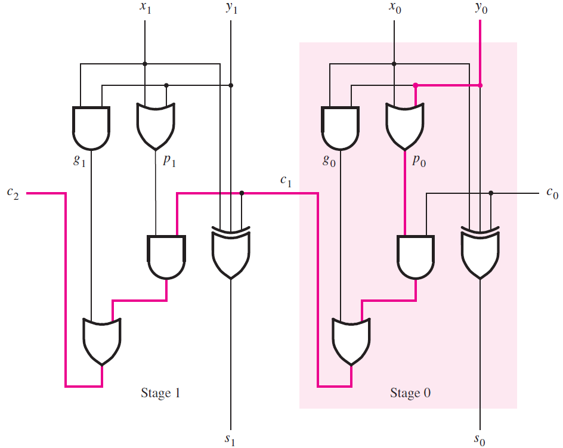
Contd.
A ripple-carry adder based on expression 1
Figure shows the first two stages of a ripple-carry adder.
In each stage, an extra OR gate is used (which produces the p_{i} signal), instead of an AND gate
because we factored the sum-of-products expression for c_{i+1}.
The slow speed of the ripple-carry adder is caused by the long path along which a carry signal must propagate.
Here, the critical path is from inputs x₀ and y₀ to the output c₂.
It passes through five gates, as highlighted in pink.
The path in other stages of an n-bit adder is the same as in stage 1.
Therefore, the total number of gate delays along the critical path is 2n + 1.

Slide 7
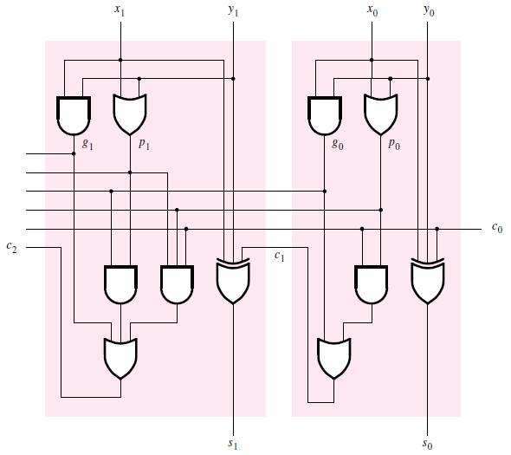
The first two stages of a carry-lookahead adder.
Figure gives the first two stages of the carry-lookahead adder, using expressions to implement the carry-out functions.
Thus
c₁ = g₀ + p₀c₀
c₂ = g₁ + p₁g₀ + p₁p₀c₀
This circuit does not have the long ripple-carry path.
Instead, all carry signals are produced after three gate delays:
one gate delay is needed to produce the generate and propagate signals g₀, g₁, p₀, and p₁, and
two more gate delays are needed to produce c₁ and c₂ concurrently.

Slide 8
Contd.
Extending the circuit to n bits, the final carry-out signal c_{n} would also be produced after only three gate delays
because of the two-level (AND-OR) circuit.
The total delay in the n-bit carry-look ahead adder is four gate delays.
The values of all g_{i} and p_{i} signals are determined after one gate delay. It takes two more gate delays to evaluate all carry signals.
Finally, it takes one more gate delay (XOR) to generate all sum bits.
The key to this good performance of the adder is quick evaluation of carry signals.

Slide 9
Hierarchical carry-look ahead adder
But, the complexity of an n-bit carry-look ahead adder increases rapidly as n becomes larger.
To reduce the complexity, we can use a hierarchical approach in designing large adders.
Suppose that we want to design a 32-bit adder. We can divide this adder into 4 eight-bit blocks, such that
block 0 adds bits 7 . . . 0, block 1 adds bits 15 . . . 8,
block 2 adds bits 23 . . . 16, and block 3 adds bits 31 . . . 24.
Then we can implement each block as an eight-bit carry-look ahead adder.
The carry-out signals from the four blocks are c₈, c₁₆, c₂₄, and c₃₂.
Now we have two possibilities. 1) We can connect the four blocks as four stages in a ripple-carry adder. Or 2) We can also have carry lookahead between blocks

Slide 10
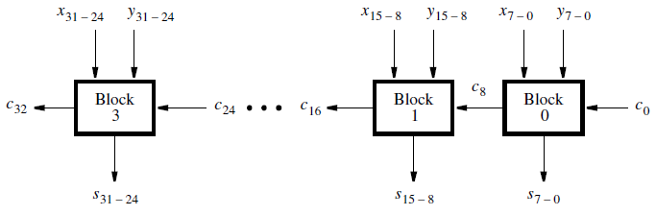
Hierarchical carry-look ahead adder with ripple-carry between blocks
Here while carry-lookahead is used within each block, the carries ripple between the blocks.

Slide 11
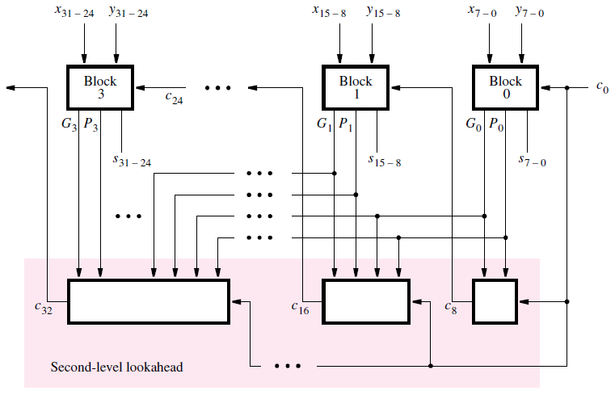
Hierarchical carry-look ahead adder.
Instead of using a ripple-carry approach between blocks, a faster circuit can be designed in which
a second-level carry-look ahead is performed to produce quickly the carry signals between blocks as below,
Each block in the top row includes an eight-bit carry-look ahead adder, based on generate and propagate signals for each stage in the block, as discussed before.
However, instead of producing a carry-out signal from the most-significant bit of the block, each block produces generate and propagate signals for the entire block.
Let G_{j} and P_{j} denote these signals for each block j.
Now G_{j} and P_{j} can be used as inputs to a second-level carry look ahead circuit at the bottom of circuit, which evaluates all carries between blocks.

Slide 12
Contd.
We can derive the block generate and propagate signals for block 0 by examining the expression for c₈
c₈ = g₇ + p₇g₆ + p₇p₆g₅ + p₇p₆p₅g₄ + p₇p₆p₅p₄g₃ + p₇p₆p₅p₄p₃g₂
+ p₇p₆p₅p₄p₃p₂g₁ + p₇p₆p₅p₄p₃p₂p₁g₀ + p₇p₆p₅p₄p₃p₂p₁p₀c₀
The last term in this expression specifies that, if all eight propagate functions are 1, then the carry-in c₀ is propagated through the entire block.
Hence, P₀ = p₇p₆p₅p₄p₃p₂p₁p₀
The rest of the terms in the expression for c₈ represent all other cases when the block produces a carry-out.
Thus, G₀ = g₇ + p₇g₆ + p₇p₆g₅ +· · ·+p₇p₆p₅p₄p₃p₂p₁g₀
The expression for c₈ in the hierarchical adder is given by
c₈ = G₀ + P₀c₀

Slide 13
Contd.
For block 1 the expressions for G₁ and P₁ have the same form as for G₀ and P₀ except that each subscript i is replaced by i + 8.
The expressions for G₂, P₂, G₃, and P₃ are derived in the same way.
The expression for the carry-out of block 1, c₁₆, is,
c₁₆ = G₁ + P₁c₈ = G₁ + P₁G₀ + P₁P₀c₀
Similarly, the expressions for c₂₄ and c₃₂ are
c₂₄ = G₂ + P₂G₁ + P₂P₁G₀ + P₂P₁P₀c₀
c₃₂ = G₃ + P₃G₂ + P₃P₂G₁ + P₃P₂P₁G₀ + P₃P₂P₁P₀c₀
Using this scheme, it takes two more gate delays to produce the carry signals c₈, c₁₆, c₂₄, and c₃₂ than the time needed to generate the G_{j} and P_{j} functions.

Slide 14
Contd.
Therefore, since G_{j} and P_{j} require three gate delays, c₈, c₁₆, c₂₄, and c₃₂ are available after five gate delays.
The time needed to add two 32-bit numbers involves these five gate delays plus two more to produce the internal carries in blocks 1, 2, and 3, plus one more gate delay (XOR) to generate each sum bit.
This gives a total of eight gate delays.
But it had taken 2n + 1 gate delays to add two numbers using a ripple-carry adder.
For 32-bit numbers this implies 65 gate delays.
Thus, it is clear that the carry-look ahead adder offers a large performance improvement with a trade-off of much greater complexity of the required circuit.

Slide 15
Technology Considerations
The preceding delay analysis assumes that gates with any number of inputs can be used. But, the number of gate inputs, referred to as the fan-in of the gate, has to be limited in practice.
Fan-in is the number of inputs to the gates
Fan-out is the number of gates driven by the gate
Therefore the reality of fan-in constraints must be taken into account.
To illustrate this problem, consider the expressions for the first eight carries:
c₁ = g₀ + p₀c₀
c₂ = g₁ + p₁g₀ + p₁p₀c₀
……...
c₈ = g₇ + p₇g₆ + p₇p₆g₅ + p₇p₆p₅g₄ + p₇p₆p₅p₄g₃ + p₇p₆p₅p₄p₃g₂ + p₇p₆p₅p₄p₃p₂g₁ + p₇p₆p₅p₄p₃p₂p₁g₀ + p₇p₆p₅p₄p₃p₂p₁p₀c₀

Slide 16
Contd.
Suppose that the maximum fan-in of the gates is four inputs. Then it is impossible to implement all of these expressions with a two-level AND-OR circuit.
The biggest problem is c₈, where one of the AND gates requires nine inputs; moreover, the OR gate also requires nine inputs.
To meet the fan-in constraint, we can rewrite the expression for c₈ as
c₈ = (g₇ + p₇g₆ + p₇p₆g₅ + p₇p₆p₅g₄) + [(p₇p₆p₅p₄)(g₃ + p₃g₂ + p₃p₂g₁ + p₃p₂p₁g₀)] + ( p₇p₆p₅p₄)( p₃p₂p₁p₀)c₀
To implement this expression we need 11 AND gates and 3 OR gates.
The propagation delay in generating c₈ consists of one gate delay to develop all g_{i} and p_{i},
two gate delays to produce the sum-of-products terms in parentheses,
one gate delay to form the product term in square brackets, and
one delay for the final ORing of terms.

Slide 17
Contd.
Hence c₈ is valid after five gate delays, rather than the three gate delays that would be needed without the fan-in constraint.
Because fan-in limitations reduce the speed of the carry-lookahead adder, some devices that are characterized by low fan-in include dedicated circuitry for implementation of fast adders.
Examples of such devices is FPGA (Field Programmable Gate Array).

Slide 18
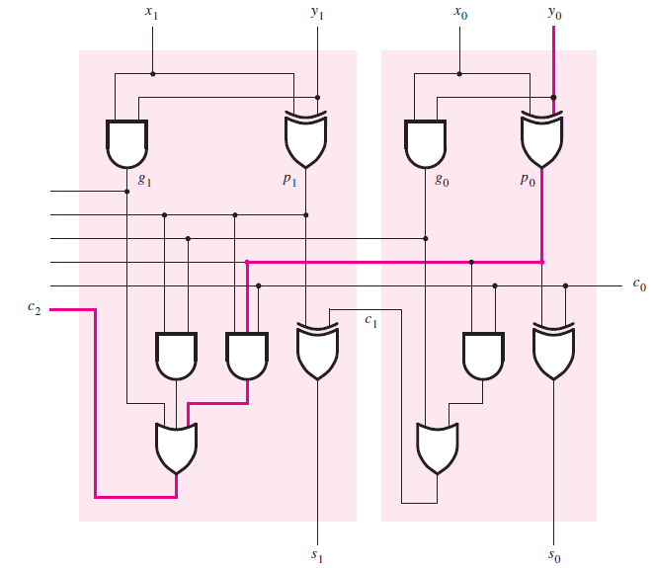
An alternative design for a carry-lookahead adder
The same functionality of carry lookahead adder can be achieved by using the circuit in Figure.
In this case stage 0 is implemented such that 2 two-input XOR gates are used to generate the sum bit, rather than having 1 three-input XOR gate.
The output of the first XOR gate can also serve as the propagate signal p₀.
Thus the corresponding OR gate is not needed.
Stage 1 is constructed using the same approach.

